Slide 1
Music on the Mind?
I signed up for choir, now what?
By Becca Morse

Slide 2
YOU MEAN I HAVE TO SING?!
Yes, in choir we sing! But you don’t have to sing a solo if you don’t want to!
Disclosure overview
Grades
Performance Attendance
In Class Performances
Concerts
Attendance

Slide 3
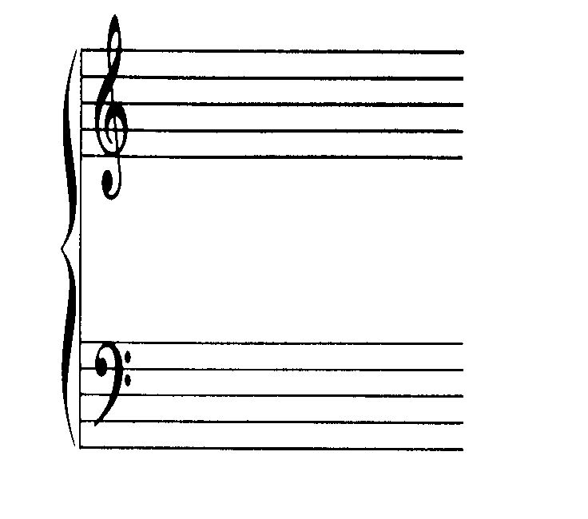
What part should I sing?
Soprano
Alto
Tenor
Bass

Slide 4
Where Should I sit?
Altos
Tenors
Sopranos
Basses
Front!!

Slide 5
Knowing Note Values!!
= a whole note.
= a half note. Two half notes make a whole note.
= a quarter note. Four quarter notes make a whole note.
= a dotted half note. Three quarter notes make a dotted half note.
= an eighth note. Two eighth notes make a quarter note.

Slide 6
The Most Common Time Signatures

Slide 7
Sight Singing Intro
IT IS OKAY TO MAKE MISTAKES!!!!!

Slide 8
Sight Singing Intro Cntd.
Always read at least one measure ahead.
Don’t be shy, the more confident you are, the better you sing.
If the notes go up, so does your voice.
If the notes go down, so does your voice.

Slide 9
Rules for this class!!
Be Respectful.
Give it a shot, have an open mind.
Don’t give up.
Try new things, all the time!
Most importantly, have fun, that is what music is all about!
Welcome to Class!!!

